Slide 1
Basics of Memories

Slide 2
Lecture 43 Basic concepts of Concepts of PLA, PAL, CPLD, FPGA
Lecture delivered by:
Deepak V.

Slide 3
Objectives
At the end of this lecture, student will be able to:
Acquire the knowledge of programmable logic devices
Acquire the knowledge of PLA, PAL, CPLD, FPGA

Slide 4
Topics
Programmable Logic Devices

Slide 5
PLD
Problems by Using Basic Gates
Many components on PCB:
As no. of components rise, nodes interconnection complexity grow exponentially
Growth in interconnection will cause increase in interference, PCB size, PCB design cost, and manufacturing time

Slide 6
PLD
The purpose of a PLD device is to permit elaborate digital logic designs to be implemented by the user in a single device
Can be erased electrically and reprogrammed with a new design, making them very well suited for academic and prototyping
Types of Programmable Logic Devices
SPLDs (Simple Programmable Logic Devices)
ROM (Read-Only Memory)
PLA (Programmable Logic Array)
PAL (Programmable Array Logic)
GAL (Generic Array Logic)
CPLD (Complex Programmable Logic Device)
FPGA (Field-Programmable Gate Array)

Slide 7
PLD
The first three varieties are quite similar to each other:
They all have an input connection matrix, which connects the inputs of the device to an array of AND-gates.
They all have an output connection matrix, which connect the outputs of the AND-gates to the inputs of OR-gates which drive the outputs of the device.
The gate array is significantly different and will be described later.

Slide 8
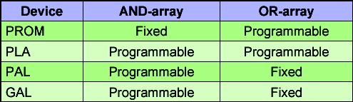
PLD
The differences between the first three categories are these:
In a ROM, the input connection matrix is hardwired. The user can modify the output connection matrix.
In a PAL/GAL the output connection matrix is hardwired. The user can modify the input connection matrix.
In a PLA the user can modify both the input connection matrix and the output connection matrix.

Slide 9
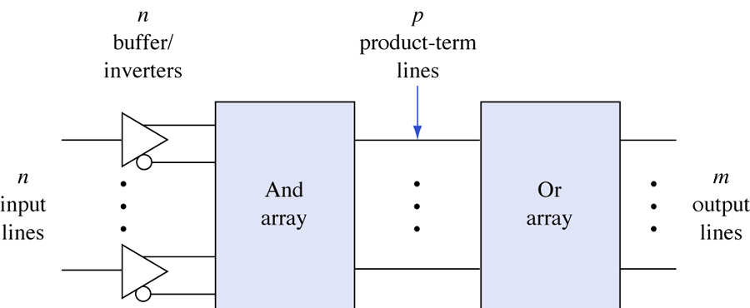
General structure of PLDs

Slide 10
PLD as a Black Box
Logic gates
Inputs
and
Outputs
(logic variables)
programmable
(logic functions)
switches

Slide 11
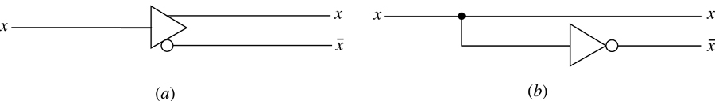
Buffer/inverter
(a) Symbol. (b) Logic equivalent.

Slide 12
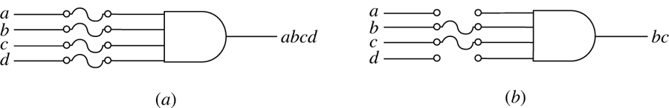
Programming by blowing fuses.
(a) Before programming. (b) After programming.

Slide 13
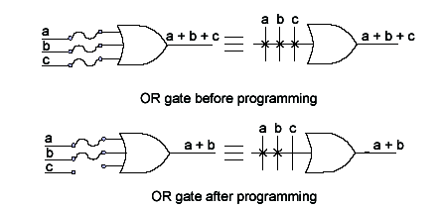
OR - PLD Notation

Slide 14
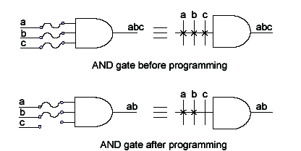
AND - PLD Notation

Slide 15
Summary
As number of components rise, nodes interconnection complexity grow exponentially
The purpose of a PLD device is to permit elaborate digital logic designs to be implemented by the user in a single device
Can be erased electrically and reprogrammed with a new design, making them very well suited for academic and prototyping

